Slide 1
UKG Ready: Employee Training
UKG Ready Training
Notes:
Note to developers: If you prefer one of the other title slides, right click and select Layout. Then select the title slide you prefer.

Slide 2
Employee Common Tasks
Notes:
TOPIC TRANSITION SLIDE – Use to introduce a topic
**Introduce topic and set expectations of what is covered in the topic.
------------- Sample Instructor Script----------
Discussion: When you think of earnings, what types of earnings come to mind that employee’s might be paid?
Earnings codes are an essential building block in our payroll processing – they are used to differentiate the different types of earnings.
DEMO: Can demo Jury duty and then go over car allowance setup,
(Company Settings > Payroll Setup > Earnings Codes - 2 methods to add…what do you think they are? (add new and clone_
- Learner Guide exercises begin on Pg 10)
Learner Guide Exercise 1 add new earnings code for Car allowance.
Learner Guide Exercise 2 (on your own) create or clone Expense Reimbursements earnings code
Learner Guide Exercise 3 (optional) Create a new earning code for Leave of Absence
Add’l examples - Jury Duty – Bereavement – Severance
(Pg 283 in user guide)

Slide 3
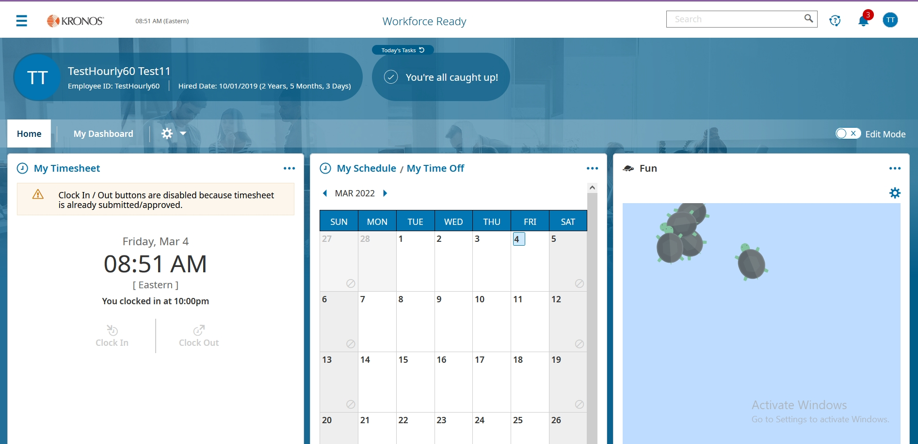
Employee Dashboard Upon Logging In

Slide 4
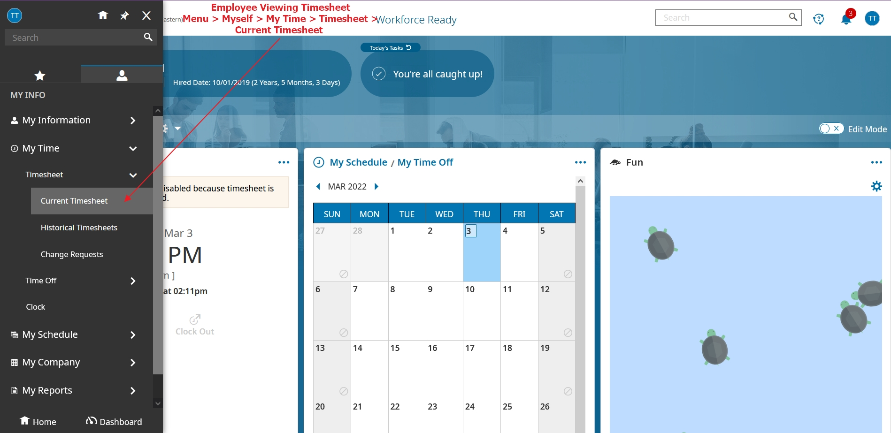
Viewing Your Timesheet From Menu

Slide 5
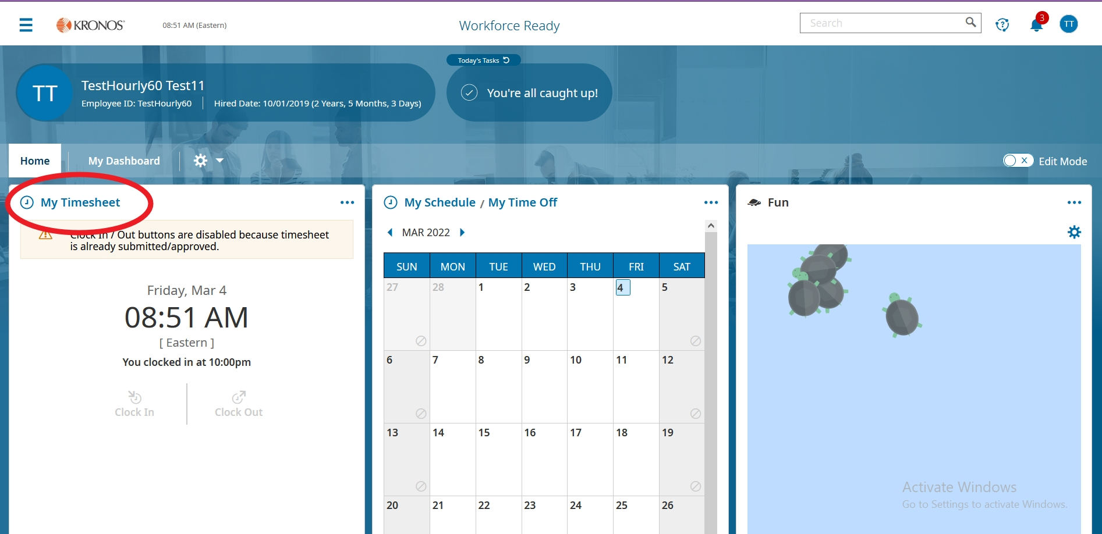
Viewing Your Timesheet From Dashboard

Slide 6
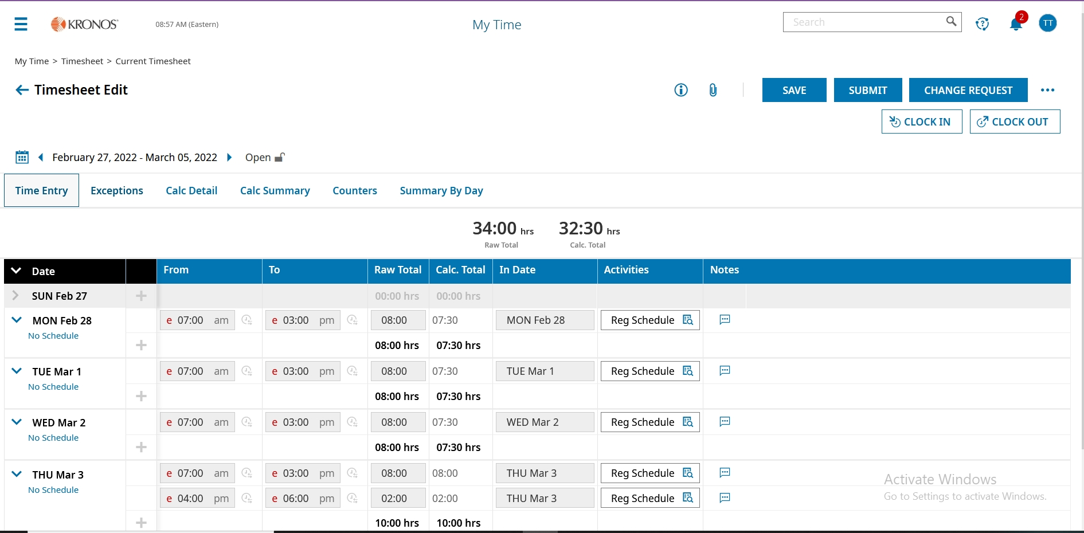
Timesheet

Slide 7
Submitting Your Timesheet
Make any corrections to your timesheet and then Submit.

Slide 8
Requesting a Change to Your Timesheet
If you need to make a change to the timesheet, select Change Request.

Slide 9
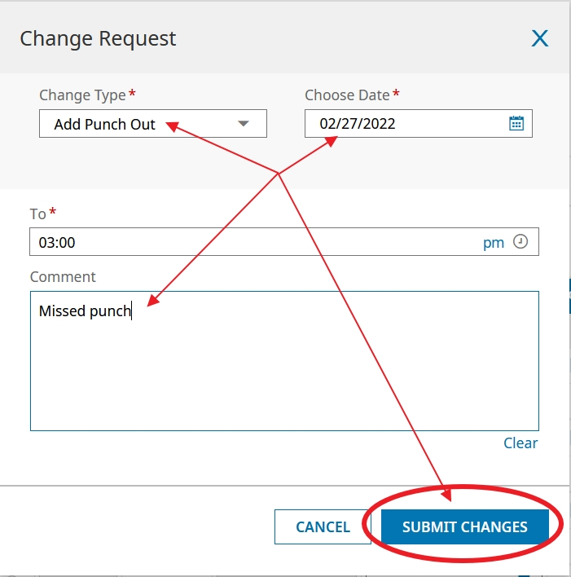
Requesting a Change to Your Timesheet
Fill out all boxes with red asterix. Then Submit changes. This sends it to manager to be approved.

Slide 10
1. Request Time Off From Timesheet
There are a few different ways to request Time Off.

Slide 11
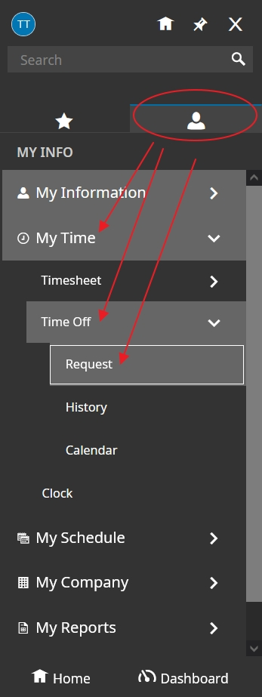
2. Submitting a Time Off Request From Menu

Slide 12
3. Dashboard: Request Time Off

Slide 13
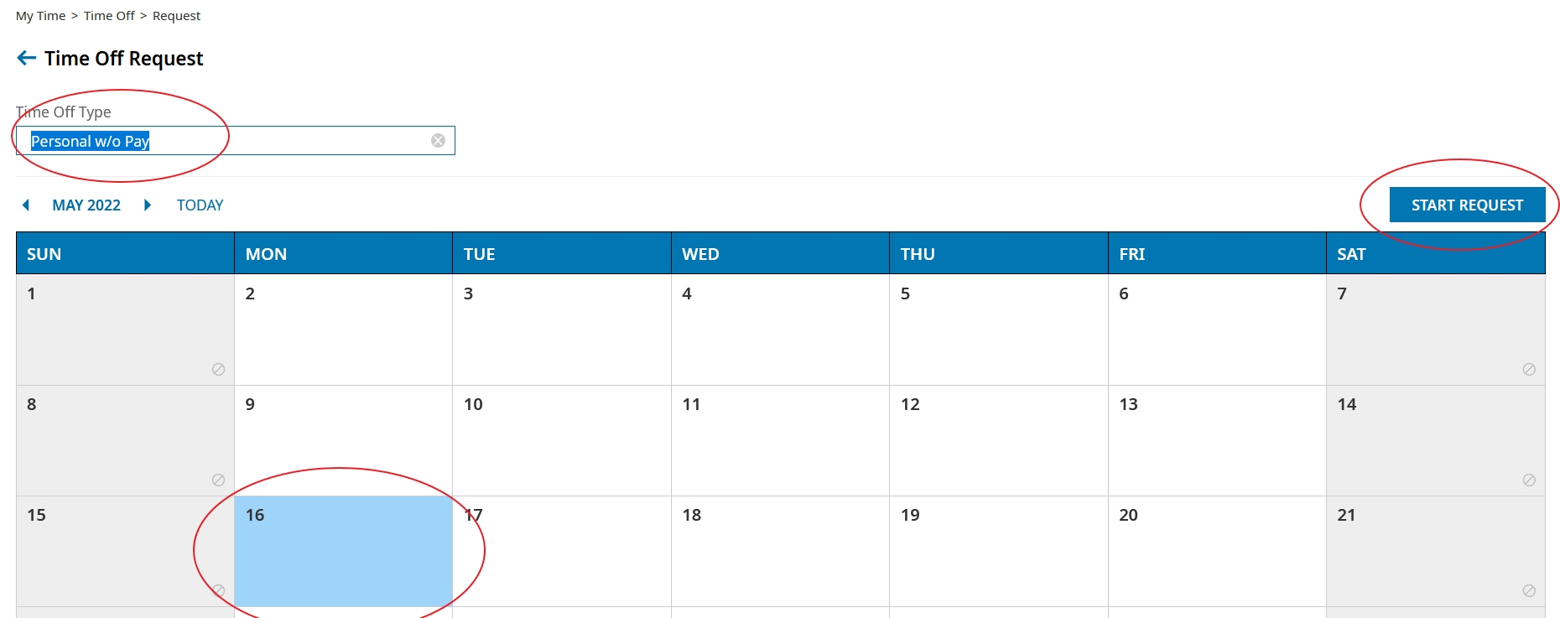
4. Dashboard Calendar Request Time Off

Slide 14
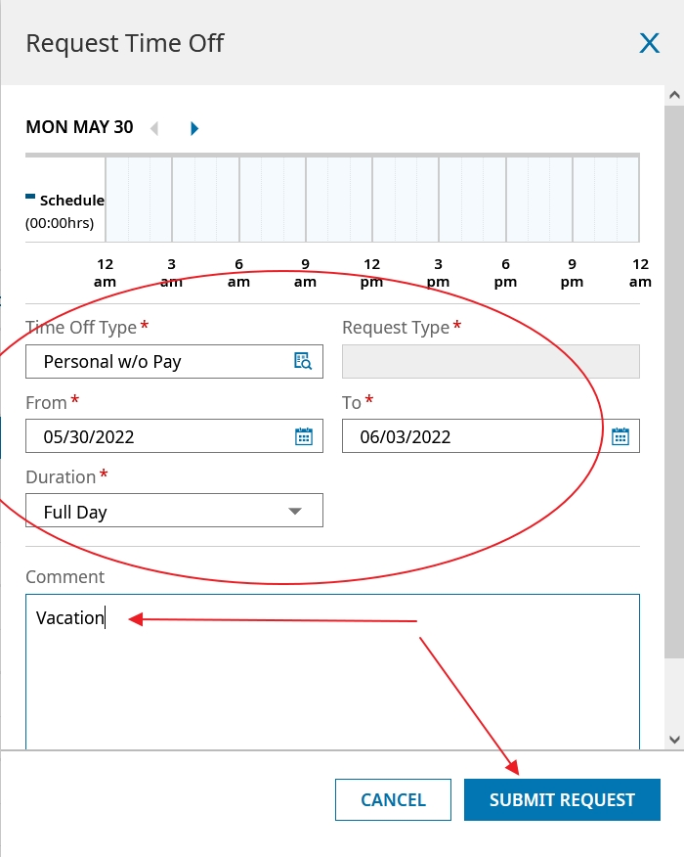
Submit a Time Off Request
Fill out boxes with red asterix and then Submit Request. This sends request to management.

Slide 15
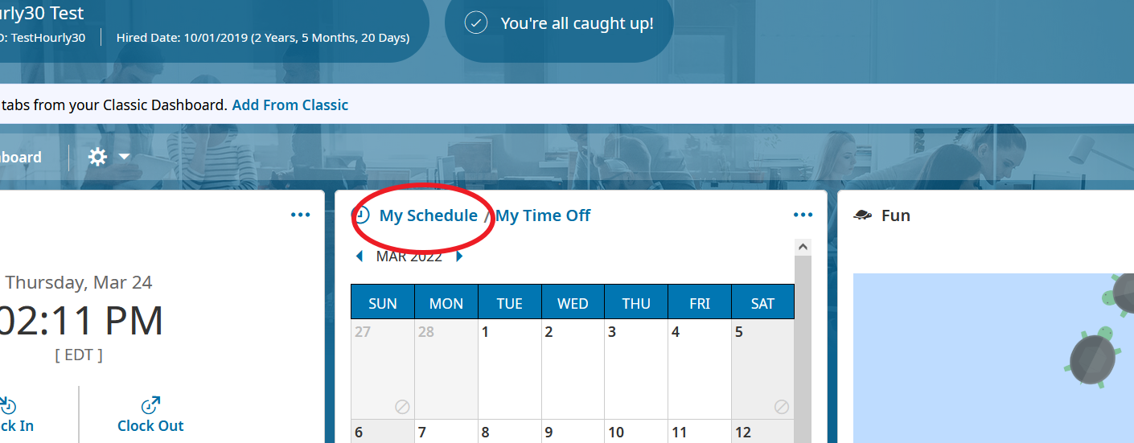
Viewing Your Schedule From Dashboard

Slide 16
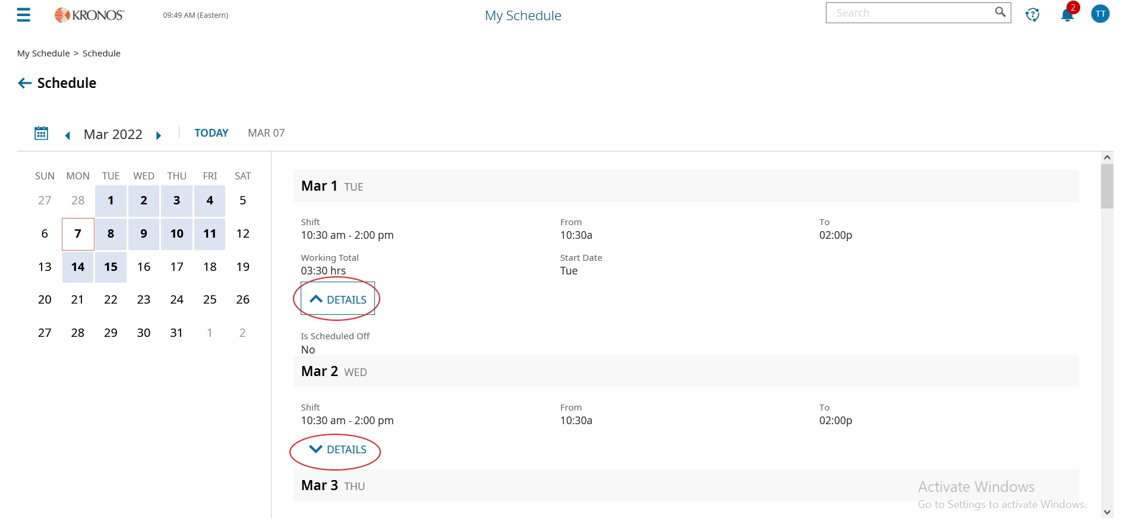
Viewing Your Schedule
You can click the arrow for more or less details

Slide 17
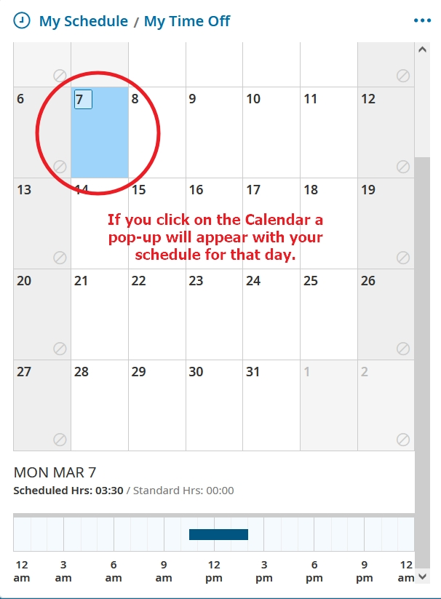
Viewing Your Schedule
Click on 1 day of the calendar for a quick glance

Slide 18
Changing Cost Center From the Timesheet
Can use this for extra duties

Slide 19
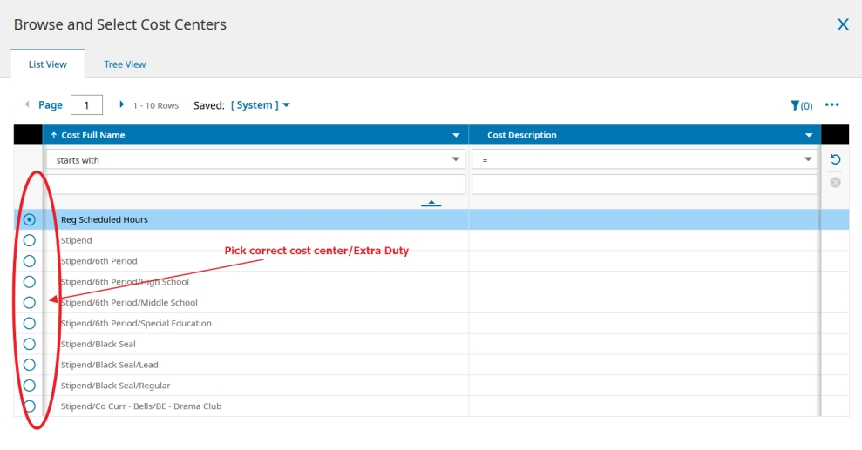
Changing Cost Center
Select the Cost Center needed.

Slide 20
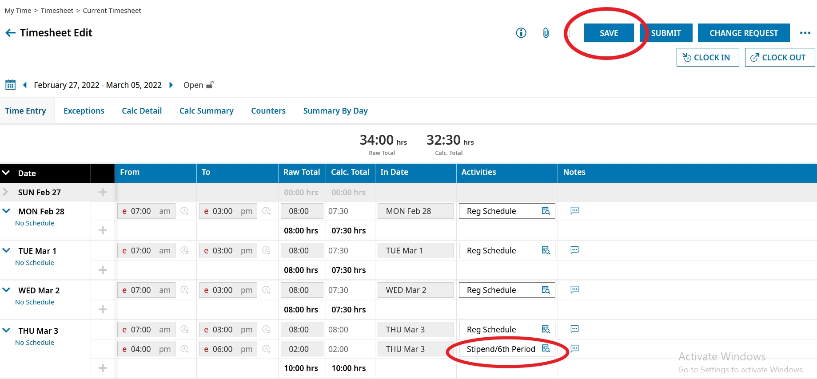
Changing Cost Centers From Timesheet
After you selected the correct cost center change, click SAVE.

Slide 21
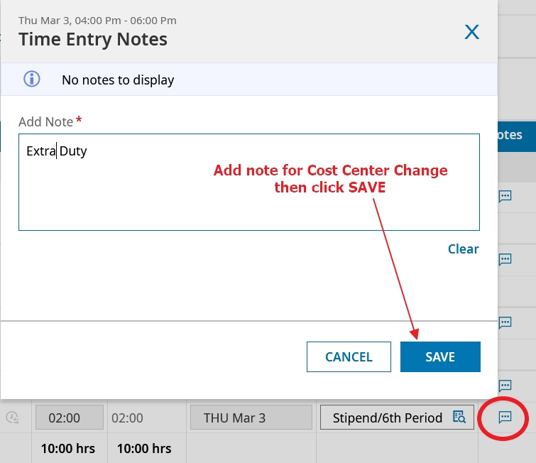
Using the Notes field for Cost Center Change
If needed include note explaining cost center change.

